Slide 1



Parallel Applications Workshop, Alternatives to MPI+X
November 19th, 2021
Held in conjunction with SC21: The International Conference for
High Performance Computing, Networking, Storage, and Analysis
In cooperation with:

Slide 2
OpenSHMEM
Barbara Chapman (HPE, Stony Brook University)
In cooperation with:

Slide 3
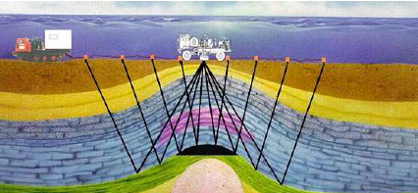
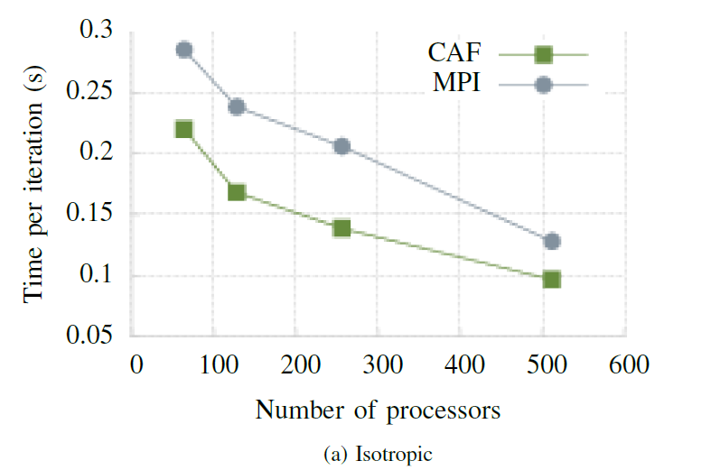
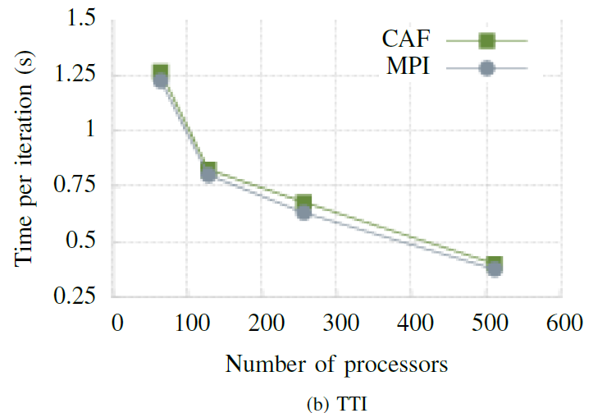
CAF in Oil & Gas: Reverse-time Migration
RTM (in time domain) uses finite difference method to numerically solve wave equation and reconstruct subsurface image (in parallel, with domain decomposition)
Fortran co-arrays implemented by Deepak Eachempati in OpenUH
Co-Array Fortran (CAF) performance similar to MPI
Forward Shot
Comparison
Total Domain Size: 1024 x 768 x 512 (3.0 GB, per shot)
Comparison: OpenUH CAF, Intel MPI
CAF port and results by Alan
Richardson, Summer 2012 Internship,
Total.
Notes:
CUSTOM APPLICATIONS
Lot of diversity and innovation in techniques
Most application codes are custom developed
Programming languages (Fortran, C++), not frameworks
Some are extremely large and complex, often developed over long period of time
A source wave is emitted per shot
Reflected waves captured by array of sensors
RTM (in time domain) uses finite difference method to numerically solve wave equation and reconstruct subsurface image (in parallel, with domain decomposition)
Isotropic
simplest model
assumes reflected waves propagate at same speed in every direction from a point
only swaps faces (6 swaps in halo exchange)
Tilted Transverse Isotropy (TTI)
assumes waves may propagate at different speeds
swaps faces and edges (18 swaps in halo exchange)
We observe that CAF compares favorably to the corresponding MPI implementation for the forward shot. These results were obtained without the use of asynchronous support in CAF. We will be gathering new results using non-blocking communication during this semester.

Slide 4
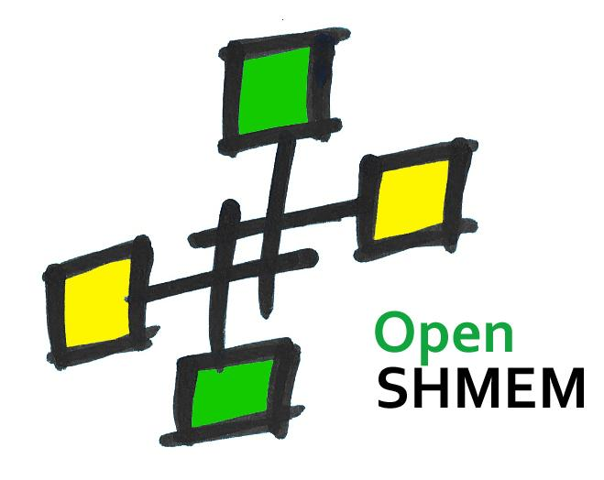
OpenShmem
OpenSHMEM: A PGAS Library
Interconnects (e.g. Infiniband, GNI, OPA); shared memory (e.g. knem, xpmem)
Point-to-point RDMA and Contexts
Teams and Collectives
Atomics, locks
Dynamic memory management
Open specification
Community driven
Various implementations
SBU / OSSS, Open-MPI, SOS, MVAPICH2-X
OSHMPI
Vendor: Cray/IBM/…
Research efforts at Stony Brook
Implementation with PMIx, UCX
Benchmarks like TaskBench
Threading interaction
Extensions
Active Messages
GPUs
FFI with Rust, Go! etc.
Specification committee
The shape of things to come
Smart NICs
Persistent Memory
NVM
FAM
Tony Curtis, Wenbin Lu,
Stony Brook University
http://www.openshmem.org/

Slide 5
Cray SHMEM to Cray OpenSHMEMX
SHMEM has a long history on HPE Cray systems
Extensively used since 1993, starting from Cray T3D systems
HPE supports two different proprietary SHMEM implementations
Cray SHMEM
Production implementation on Cray XC systems
Optimized to support OpenSHMEM programming model on Cray-developed Aries interconnect
Cray OpenSHMEMX
OpenSHMEM standards compliant implementation
Introduced in 2018 as a replacement for Cray SHMEM
Supports OpenSHMEM programming model on multiple systems
Optimized for HPE Cray EX supercomputer systems
Available on Cray XC and HPE Apollo systems
Provides support on different interconnects like HPE Slingshot, Cray-developed Aries, and Mellanox IB
Notes:
Here is the result of TaskBench using my active message implementation as a back-end.
Unfortunately, I couldn’t get the Legion and Charm++ backends of TaskBench to work on Ookami because their ARM support isn’t perfect yet. (Seawulf has broken IB drivers.)
So, I’ve only compared the official MPI backend, a signal based OpenSHMEM backend, and my active message backend.
On 8 nodes, my active message implementation outperforms both the MPI backend and the OpenSHMEM signals backend for all task sizes.
This is because implementing task injection using active messages is a better approach than the bulk-synchronous style used in the other two backends.
Therefore, we conclude that my OpenSHMEM active message extension is flexible enough to interact w/ shared-memory tasks, and has shown promising results when compared to other programming models.

Slide 6

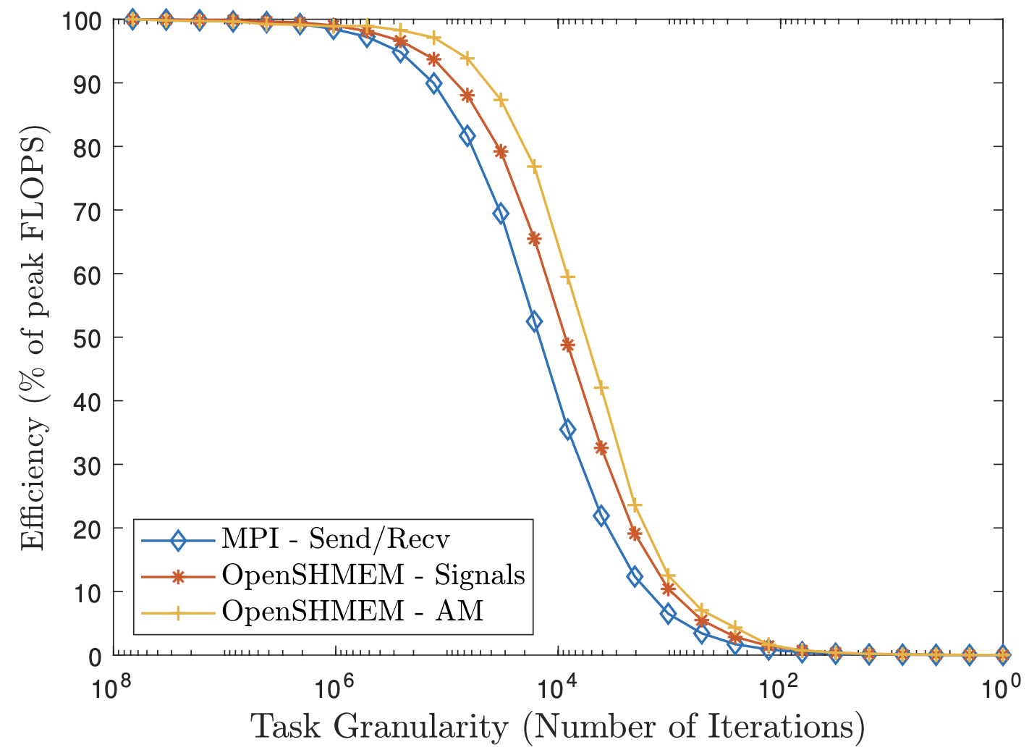
Active Message Performance TaskBench
Courtesy Wenbin Lu
Notes:
Here is the result of TaskBench using my active message implementation as a back-end.
Unfortunately, I couldn’t get the Legion and Charm++ backends of TaskBench to work on Ookami because their ARM support isn’t perfect yet. (Seawulf has broken IB drivers.)
So, I’ve only compared the official MPI backend, a signal based OpenSHMEM backend, and my active message backend.
On 8 nodes, my active message implementation outperforms both the MPI backend and the OpenSHMEM signals backend for all task sizes.
This is because implementing task injection using active messages is a better approach than the bulk-synchronous style used in the other two backends.
Therefore, we conclude that my OpenSHMEM active message extension is flexible enough to interact w/ shared-memory tasks, and has shown promising results when compared to other programming models.

Slide 7
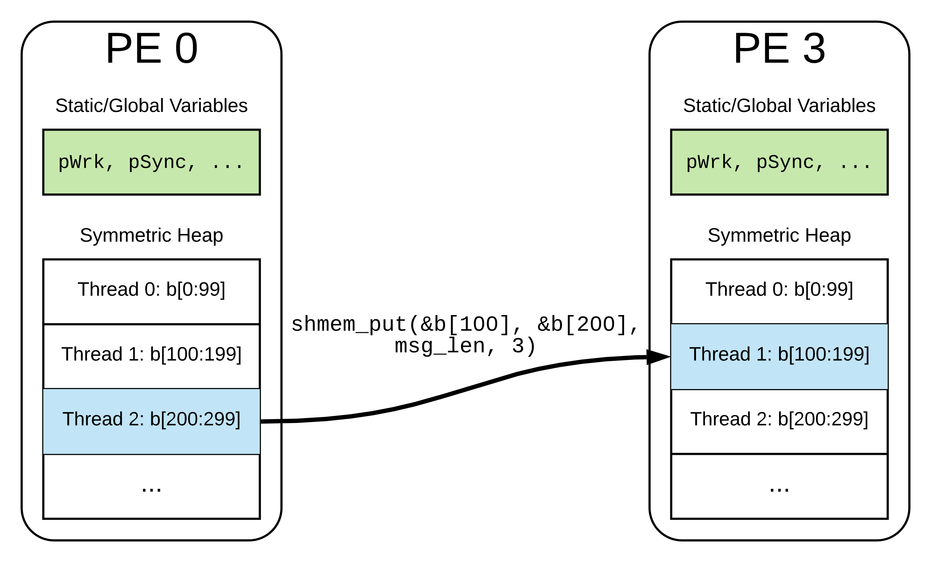
Multi-threaded Messaging with RMA
Threads can use designated segments on the symmetric heap as private communication buffers
Very low overhead
shmem_test
shmem_wait_until
Put with signal
Wenbin Lu, Tony Curtis and Barbara Chapman, “Enabling Low-Overhead Communication in Multi-threaded OpenSHMEM Applications using Contexts”, In 2019 IEEE/ACM Parallel Applications Workshop, Alternatives To MPI (PAW-ATM)
Notes:
Sending a message to a thread is equivalent to send to a specific offset on the heap.

